Slide 1
HSI #1921
-Ruth Chandler Ferris

Slide 2
As each quadrant is uncovered, record your observations under: people, objects, and activities. Based on your observations, list three things you might infer from this photograph.
 | People | Objects | Activities
Quadrant 1
Quadrant 2
Quadrant 3
Quadrant 4
1.
2.
3.

Slide 3
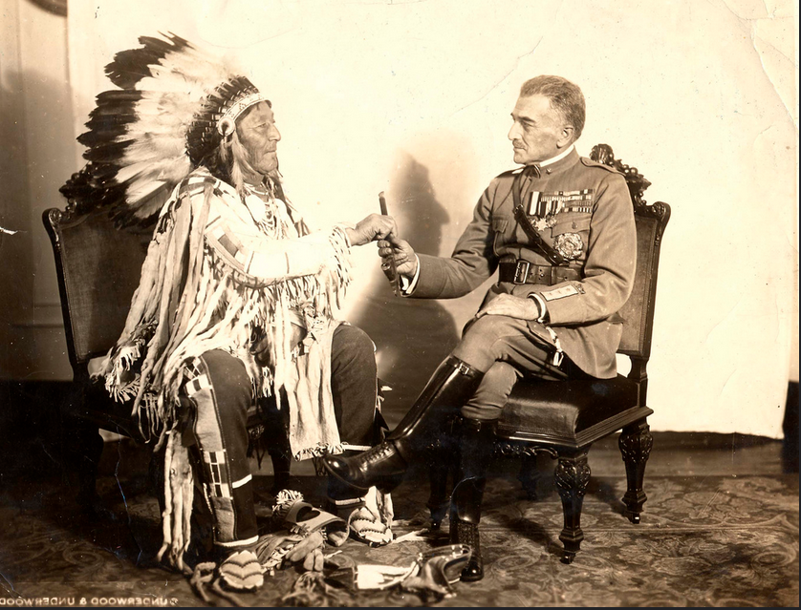
Notes:
http://cdm16280.contentdm.oclc.org/cdm/singleitem/collection/p4007coll4/id/1191/rec/2
http://cdm16280.contentdm.oclc.org/cdm/singleitem/collection/p4007coll4/id/1191/rec/2
Chief Plenty Coups (Crow) and General Diaz (Italian), 1920
Chief Plenty Coups (Crow) and General Armando Diaz (Italian), two veterans of World War I, by Underwood & Underwood, Washington, D.C., 1920
Image courtesy Marquette University Archives, 10637

Slide 4
As each quadrant is uncovered, record your observations under: people, objects, and activities. Based on your observations, list three things you might infer from this photograph.
 | People | Objects | Activities
Quadrant 1
Quadrant 2
Quadrant 3
Quadrant 4
1.
2.
3.

Slide 5
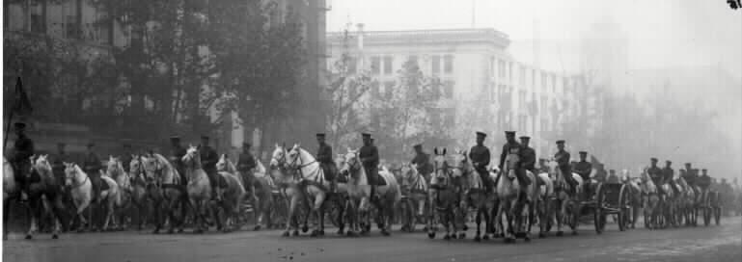
Notes:
http://www.arlingtoncemetery.net/unk-wwi.htm Horse Drawn Artillery (US Army Photo)

Slide 6
As each quadrant is uncovered, record your observations under: people, objects, and activities. Based on your observations, list three things you might infer from this photograph.
 | People | Objects | Activities
Quadrant 1
Quadrant 2
Quadrant 3
Quadrant 4
1.
2.
3.

Slide 7
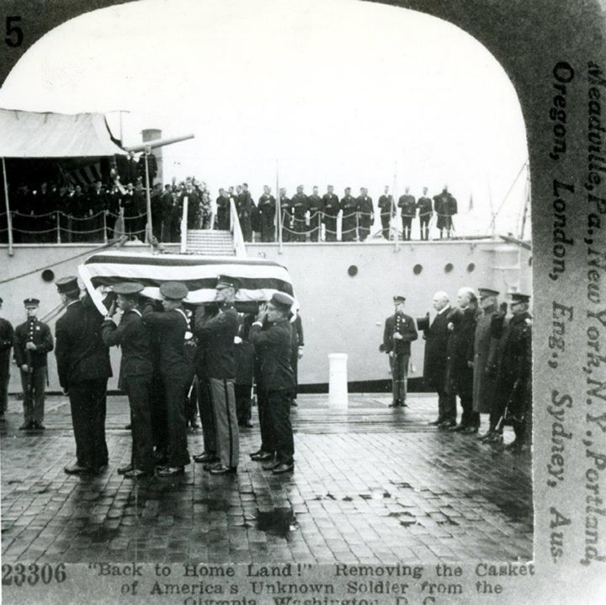
Notes:
https://www.facebook.com/navalhistory/photos/a.10150941541088344.399034.76845133343/10150941542533344/ Naval History Return of the Unknown Soldier of World War I. Stereo-card photo showing the casket being removed from USS Olympia (C-6) at the Washington Navy Yard, D.C. after being brought back from France, circa 9 November 1921. At extreme right are: (left to right): Secretary of the Navy Edwin Denby; General J.J. Pershing, and Admiral R.E. Coontz. Stereo-card published by Keystone View Co. Courtesy of CDR J. J. Robinson, USN, (Retired), 1980. NHHC Photograph Collection, NH 91488.

